Slide 1




Making Text Editor App: Implementing Stack Operations for Enhanced Functionality
PRESENTED BY:
HAROONIMRAN-14723

Slide 2



Introduction to Text Editing
In today's digital landscape, text editing is crucial for productivity. This presentation explores optimizing text editing through the implementation of stack operations. We will discuss the benefits and functionalities that enhance user experience and e ciency.

Slide 3



Understanding Stack Operations
Stack operations, such as push and pop, allow for e cient management of data. In text editing, these operations can help maintain an organized structure for undoing and redoing actions, which is essential for a seamless editing experience.

Slide 4

Bene its of Stack Implementation
Implementing stack operations in text editing provides several benefits: improved performance, enhanced user control, and a more intuitive interface. Users can easily navigate their edits, making the process smoother and more e cient.

Slide 5



Key Stack Operations Explained
The primary stack operations include push, which adds an item to the stack, and pop, which removes the most recent item. Understanding these operations is crucial for developing a robust text editing system that users can rely on.

Slide 6




Implementing Undo Functionality
The undo feature is vital in text editing. By utilizing stack operations, users can easily revert their last actions. This enhances user confidence and encourages experimentation without fear of making irreversible mistakes.

Slide 7

Implementing Redo Functionality
Similar to undo, the redo function allows users to reapply actions they have undone. This is achieved through a second stack, ensuring that users have full control over their editing history and can navigate freely.

Slide 8



User Experience Enhancements
Integrating stack operations leads to significant user experience enhancements. Users enjoy smoother interactions and quicker access to their editing history, making the editing process more enjoyable and less frustrating.

Slide 9
Common Challenges and Solutions
While implementing stack operations can be beneficial, challenges such as memory management and performance optimization may arise. Addressing these issues with eﬀective strategies ensures a robust and
e cient text editing application.

Slide 10



Future o Text Editing
The future of text editing lies in continued innovation and the integration of advanced technologies. Stack operations will remain a fundamental aspect, enabling users to edit text more e ciently and intuitively.

Slide 11
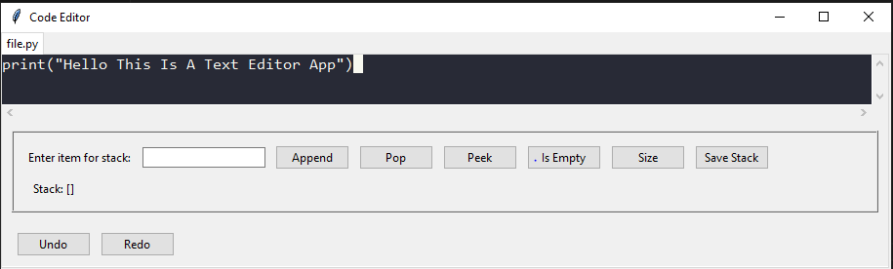
Though run Code

Slide 12

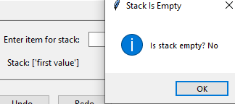
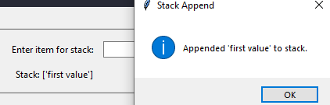
Though Interface (Append)
Though Interface
(Empty)

Slide 13
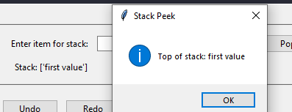
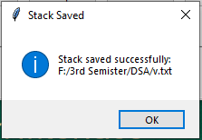
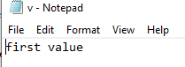
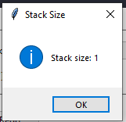
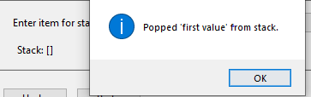
Though Interface
(Peek)
Though Interface
(Save Stack)
Though Interface
(Size and Pop)

Slide 14



Conclusion
In conclusion, optimizing text editing through stack operations significantly improves functionality and user experience. By understanding and implementing these concepts, developers can create more eﬀective and user-friendly text editing tools.

Slide 15


Thanks!
Do you have any questions?
haroonimran@gmail.com
+92 310 406 737

